Slide 1
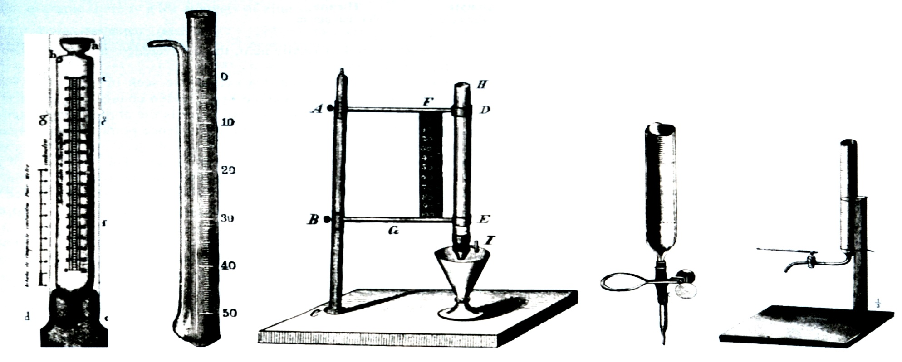
Titrations
Introduction
1.) Buret Evolution
Primary tool for titration
Gay-Lussac (1824)
Blow out liquid
Mohr (1855)
Compression clip
Used for 100 years
Descroizilles (1806)
Pour out liquid
Henry (1846)
Copper stopcock
Mohr (1855)
Glass stopcock

Slide 2
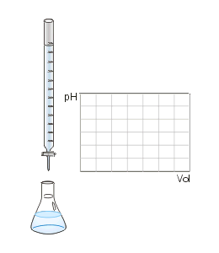
Titrations
Introduction
2.) Volumetric analysis
Procedures in which we measure the volume of reagent needed to react with an analyte
3.) Titration
Increments of reagent solution (titrant) are added to analyte until reaction is complete.
- Usually using a buret
Calculate quantity of analyte from the amount of titrant added.
Requires large equilibrium constant
Requires rapid reaction
- Titrant is rapidly consumed by analyte
Controlled Chemical Reaction

Slide 3
Titrations
Introduction
4.) Equivalence point
Quantity of added titrant is the exact amount necessary for stoichiometric reaction with the analyte
- Ideal theoretical result
Analyte
Oxalic acid
(colorless)
Titrant
(purple)
(colorless)
(colorless)
Equivalence point occurs when 2 moles of MnO₄⁻ is added to 5 moles of Oxalic acid

Slide 4
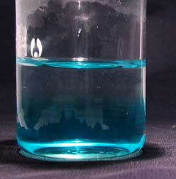
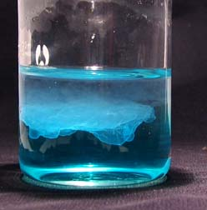
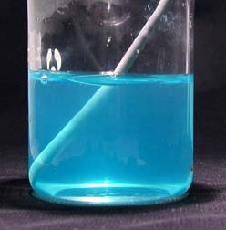
Titrations
Introduction
5.) End point
What we actually measure
- Marked by a sudden change in the physical property of the solution
- Change in color, pH, voltage, current, absorbance of light, presence/absence ppt.
CuCl Titration with NaOH
Before any addition of NaOH
After the addition of 8 drops of NaOH
End Point

Slide 5
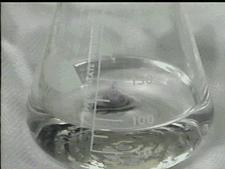
Titrations
Introduction
5.) End point
Occurs from the addition of a slight excess of titrant
- Endpoint does not equal equivalence point
Analyte
Oxalic acid
(colorless)
Titrant
(purple)
(colorless)
(colorless)
After equivalence point occurs, excess MnO₄⁻ turns solution purple → Endpoint

Slide 6
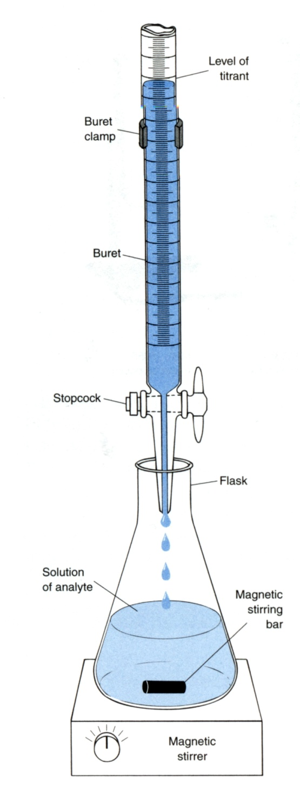
Titrations
Introduction
5.) End point
Titration Error
- Difference between endpoint and equivalence point
- Corrected by a blank titration
i. repeat procedure without analyte
ii. Determine amount of titrant needed to observe change
iii. subtract blank volume from titration
Primary Standard
- Accuracy of titration requires knowing precisely the quantity of titrant added.
- 99.9% pure or better → accurately measure concentration
Analyte
Oxalic acid
(colorless)
Titrant
(purple)

Slide 7
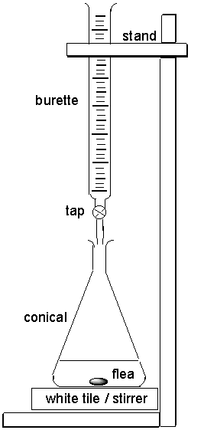
Titrations
Introduction
6.) Standardization
Required when a non-primary titrant is used
- Prepare titrant with approximately the desired concentration
- Use it to titrate a primary standard
- Determine the concentration of the titrant
- Reverse of the normal titration process!!!
Titration
Standardization
titrant known concentration
titrant unknown concentration
analyte unknown concentration
analyte known concentration

Slide 8
Titrations
Introduction
7.) Back Titration
Add excess of one standard reagent (known concentration)
- Completely react all the analyte
- Add enough MnO₄⁻ so all oxalic acid is converted to product
Titrate excess standard reagent to determine how much is left
- Titrate Fe²⁺ to determine the amount of MnO₄⁻ that did not react with oxalic acid
- Differences is related to amount of analyte
- Useful if better/easier to detect endpoint
Analyte
Oxalic acid
(colorless)
Titrant
(purple)
(colorless)
(colorless)

Slide 9
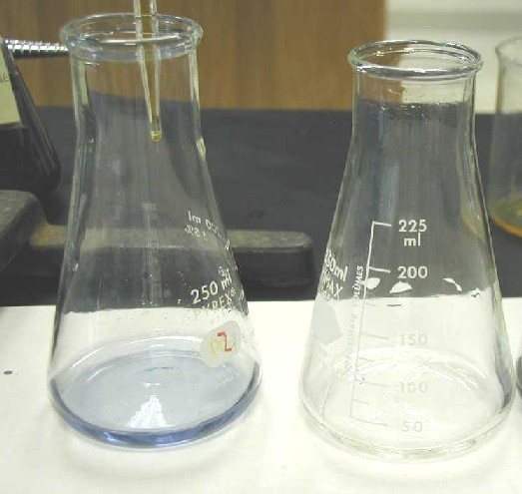
Titrations
Titration Calculations
1.) Key – relate moles of titrant to moles of analyte
2.) Standardization of Titrant Followed by Analysis of Unknown
Calculation of ascorbic acid in Vitamin C tablet:
Starch is used as an indicator: starch + I₃⁻ → starch-I₃⁻ complex
(clear) (deep blue)
(ii) Titrate ascorbic acid with I₃⁻:
1 mole ascorbic acid → 1 mole I₃⁻

Slide 10
Titrations
Titration Calculations
2.) Standardization of Titrant Followed by Analysis of Unknown
Standardization: Suppose 29.41 mL of I₃⁻ solution is required to react with 0.1970 g of pure ascorbic acid, what is the molarity of the I₃⁻ solution?

Slide 11
Titrations
Titration Calculations
2.) Standardization of Titrant Followed by Analysis of Unknown
Analysis of Unknown: A vitamin C tablet containing ascorbic acid plus an inert binder was ground to a powder, and 0.4242g was titrated by 31.63 mL of I₃⁻. Find the weight percent of ascorbic acid in the tablet.

Slide 12
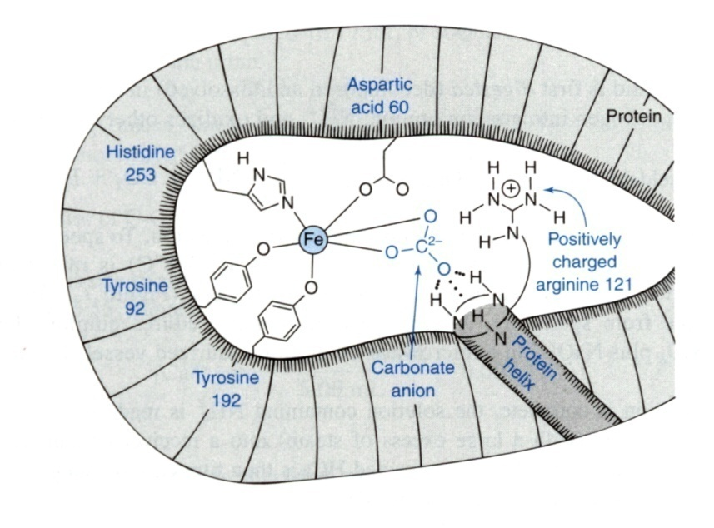
Titrations
Spectrophotometric Titrations
1.) Use Absorbance of Light to Follow Progress of Titration
Example:
- Titrate a protein with Fe³⁺ where product (complex) has red color
- Product has an absorbance maximum at 465 nm
- Absorbance is proportional to the concentration of iron bound to protein
Analyte
(colorless)
titrant
(colorless)
(red)
As Fe³⁺ binds protein
solution turns red

Slide 13
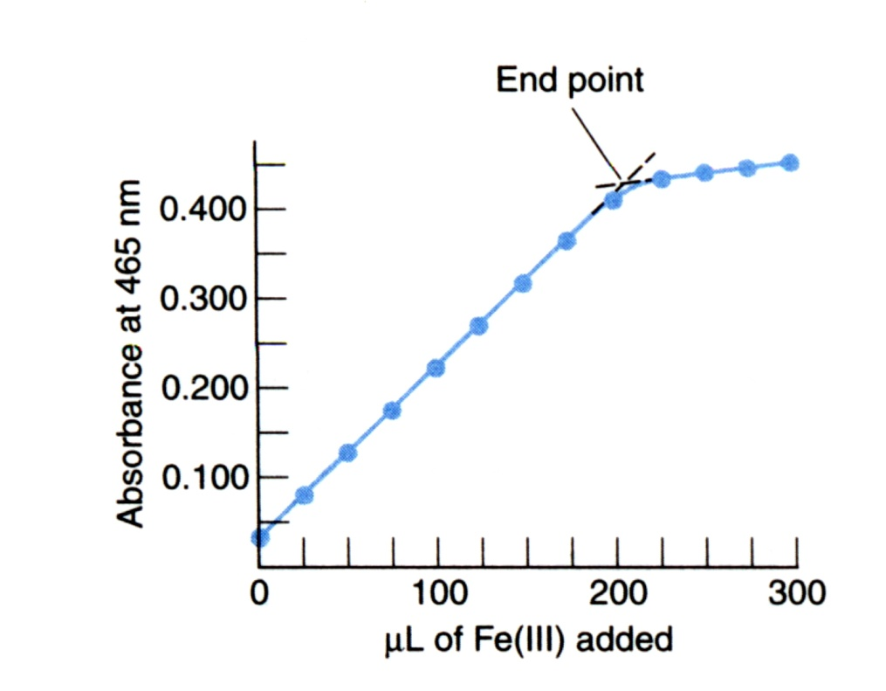
Titrations
Spectrophotometric Titrations
1.) Use Absorbance of Light to Follow Progress of Titration
Example:
- As more Fe³⁺ is added, red color and absorbance increases,
- When the protein is saturated with iron, no further color can form
- End point – intersection of two lines (titrant has some absorbance at 465nm)
When all the protein is bound to Fe³⁺,
no further increase in absorbance.
As Fe³⁺ continues to bind protein
red color and absorbance increases.

Slide 14
Titrations
Spectrophotometric Titrations
1.) Use Absorbance of Light to Follow Progress of Titration
Example:
- As more Fe³⁺ is added, concentration changes due to dilution
- Need to correct absorbance for dilution.
Total volume changes after each addition

Slide 15
Titrations
Precipitation Titration Curve
1.) Graph showing how the concentration of one of the reactants varies as titrant is added.
Understand the chemistry that occurs during titration
Learn how experimental control can be exerted to influence the quality of an analytical titration
- No end point at wrong pH
- Concentration of analyte and titrant and size of K_{sp} influence end point
- Help choose indicator for acid/base and oxidation/reduction titrations
Sharpness determined by titration condition
Monitor pH, voltage, current, color, absorbance, ppt.

Slide 16
Titrations
Precipitation Titration Curve
2.) Because concentration varies over many orders of magnitude, plot p function
3.) Example:
p function:
where [X] is concentration of X
Consider the titration of 25.00 mL of 0.1000M I⁻ with 0.05000M Ag⁺
Since K_{sp} is so small, each addition of Ag⁺ reacts completely with I⁻

Slide 17
Titrations
Precipitation Titration Curve
3.) Example:
At equivalence point, sudden increase in Ag⁺ concentration.
- All I⁻ has been consumed
What volume (V_{e}) of Ag⁺ titrant is need to reach the equivalence point?
mol I⁻
mol Ag⁺
One mole of Ag⁺ reacts with one mol I⁻

Slide 18
Titrations
Precipitation Titration Curve
4.) Three distinct regions in titration curve
Before, at and after the equivalence point.
Before the Equivalence Point
- All titrant [Ag⁺] is consumed, free [I⁻] is [I⁻] that has not been precipitated.
- Negligible I⁻ from AgI(s) (K_{sp})
after
at
before
Moles of I⁻ = original moles of I⁻ - moles of Ag⁺ added

Slide 19
Titrations
Precipitation Titration Curve
4.) Three distinct regions in titration curve
Before the Equivalence Point
- Concentration of Ag⁺ is governed by K_{sp}
Consider the titration of 25.00 mL of 0.1000M I⁻ with 10 mL of 0.05000M Ag⁺
Moles of I⁻ = original moles of I⁻ - moles of Ag⁺ added
Volume is 0.3500 L ( 25.00 mL + 10.00 mL)
Concentration of Ag⁺ in equilibrium with this much I⁻

Slide 20
Titrations
Precipitation Titration Curve
4.) Three distinct regions in titration curve
Before the Equivalence Point
- Concentration of Ag⁺ is governed by K_{sp}
At Equivalence Point
- added exactly enough Ag⁺ to react with all I⁻
- [Ag⁺] independent of the original concentrations
- [Ag⁺] dependent on K_{sp}
p function
2 sig. fig. → 2 sig. fig. in the mantissa of p function

Slide 21
Titrations
Precipitation Titration Curve
4.) Three distinct regions in titration curve
After Equivalence Point
- All Ag⁺ added before equivalence point has ppt.
- [Ag⁺] is determined by Ag⁺ added after the equivalence point.
> volume after equivalence point
For 2 mL of Ag⁺ added past equivalence point

Slide 22
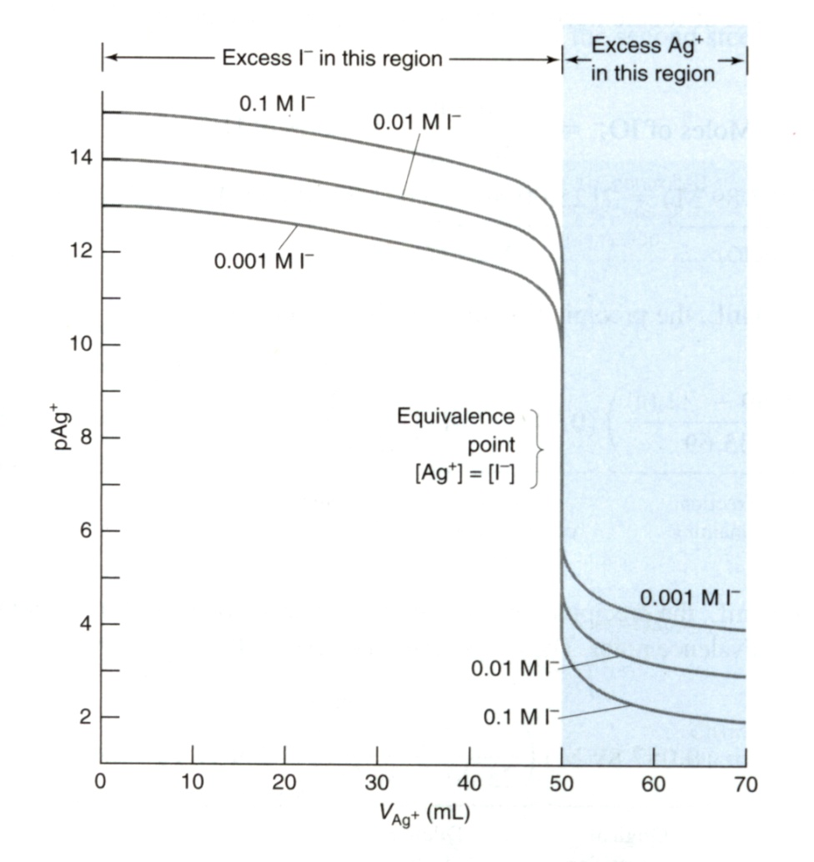
Titrations
Shape of Titration Curve
1.) Equivalence point is the steepest point of the curve.
Point of maximum slope → inflection point → second derivative is zero

Slide 23
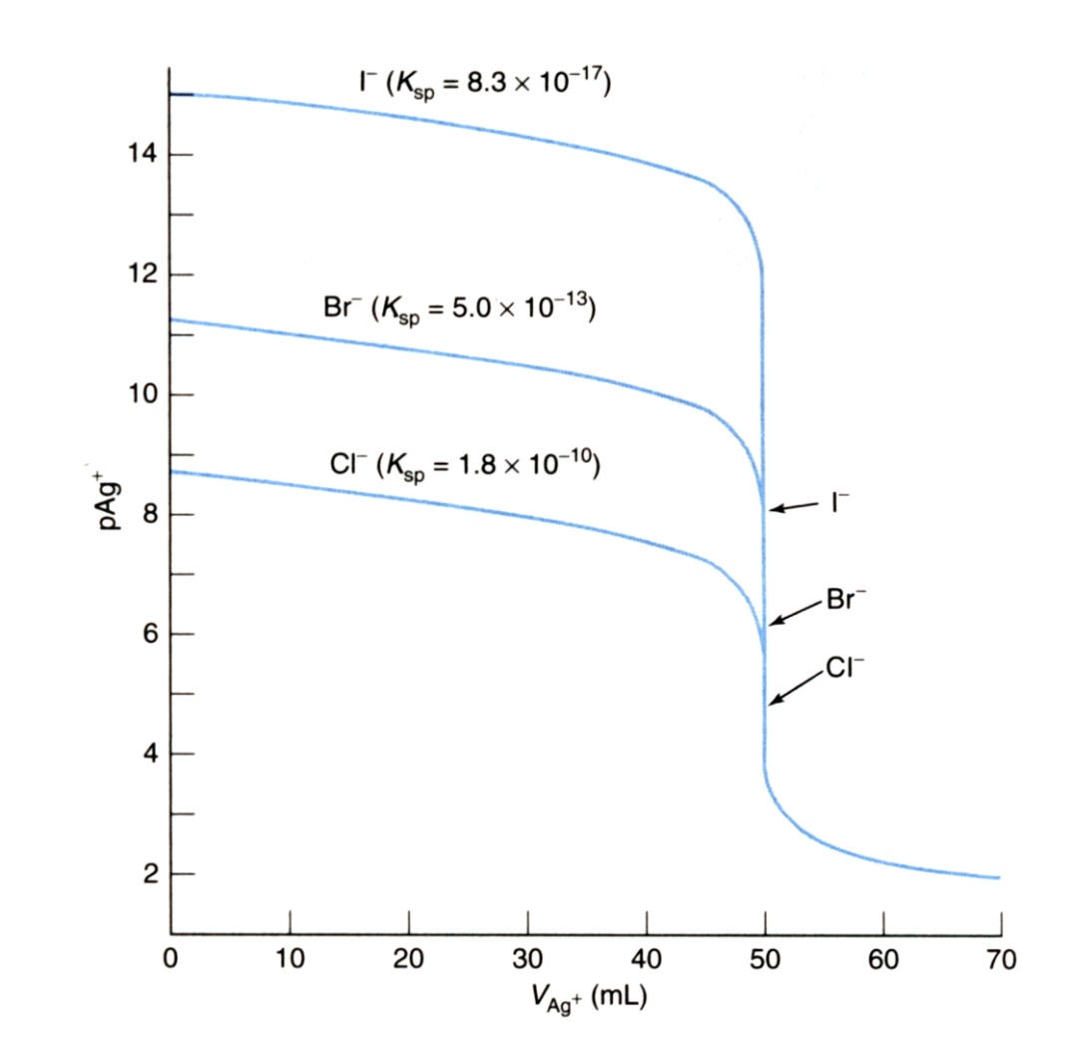
Titrations
Shape of Titration Curve
2.) Affect of K_{sp} on Titration Curve.
Lowest solubility gives steepest change at equivalence point
Magnitude of concentration change and ease of identifying equivalence point increases with K_{sp}

Slide 24
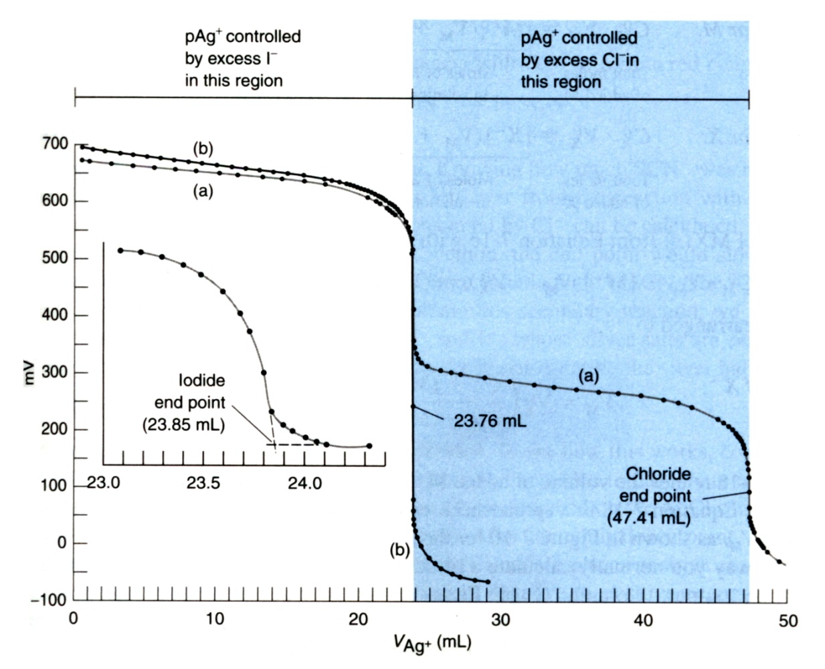
Titrations
Titration of a Mixture
1.) Product with the Smaller K_{sp} Precipitates First
Two Stage Titration Curve
- Assumes significant difference in K_{sp}
First, AgI ppt.
Titrate Mixture of KI and KCl with AgNO₃
Then, AgCl ppt.
K_{sp}(AgI) << K_{sp}(AgCl)
AgI ppt. not complete at midpoint

Slide 25
Titrations
End-Point Detection
1.) Precipitation Titration
End points detected with electrode or indicator
- Electrode – converts concentration of specific ion into measurable current or
potential.
- Indicators:
Volhard titration: formation of a soluble, colored complex at the end point
Fajans titration: adsorption of a colored indicator on the precipitate at the end
point
pH electrode responds to [H⁺]

Slide 26
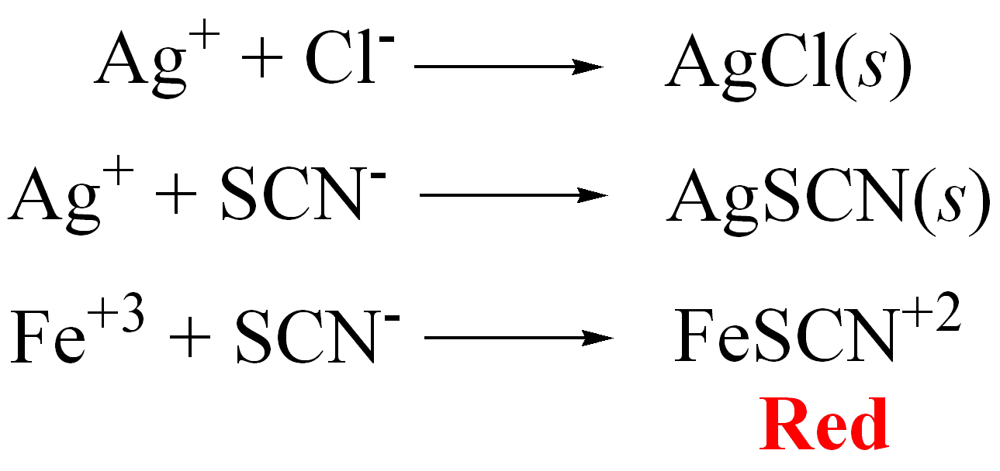
Titrations
End-Point Detection
1.) Precipitation Titration
Volhard titration (First Published in 1874)
Determine [Cl⁻]:
First ppt. Cl⁻ by titration with Ag⁺ and filter off solid
Titrate excess Ag⁺ with thiocyanate (SCN⁻)
When all Ag⁺ is consumed, thiocyanate binds Fe^{3+.} Appearance of Red color is endpoint
Total amount of Ag⁺ is known, so amount consumed by Cl⁻ can be calculated
Subtract excess [Ag⁺] from total [Ag⁺] used to ppt. Cl⁻

Slide 27
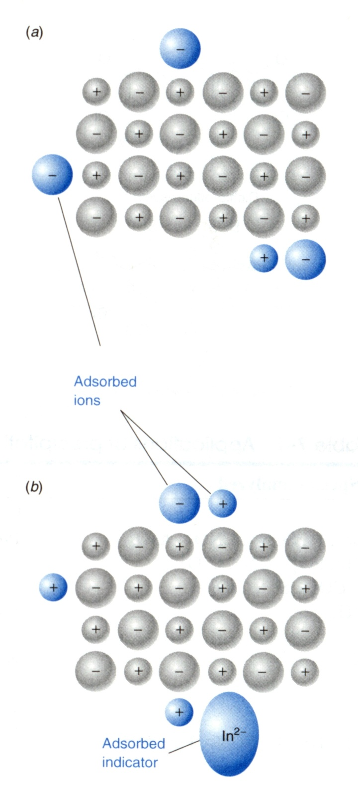
Titrations
AgCl ppt.
End-Point Detection
1.) Precipitation Titration
Fajans titration
- Uses an adsorption indicator
Precipitate surface is initially negatively charged due to excess Cl⁻
AgCl ppt.
After equivalence point (end point), have excess Ag⁺ so surface is now positively charged.
Anionic dye is attracted to positive charged surface. Adsorption of dye causes color change

Slide 28
Titrations
End-Point Detection
1.) Precipitation Titration
Fajans titration
Anionic dyes
- Maximize surface area → higher binding→ stronger color change
- small particle size → low concentration
- must use appropriate pH to maintain negative charge
Changes from greenish yellow to pink
Sharper color transition, binds to tightly to Cl⁻

Slide 29
Titrations
End-Point Detection
2.) Typical Applications
Also indicates potential sources of interference
- other ions/analytes may be present in sample

